Slide 1
Reviewgenius
Ram Elias 205445794
Eliezer Seror 312564776
Yael Seror 318345162

Slide 2
PART A:
Our PROJECT
…

Slide 3
Code project overview
Using data mining techniques to analyze hotel reviews and identify factors that influence guest satisfaction. The code uses web scraping to extract data from Booking.com, EDA to visualize ratings and metrics, sentiment analysis, tf-idf to identify important words and LDA topic modeling to cluster reviews.

Slide 4

The MODEL
LDA is a model that helps us understand the underlying topics in a set of documents. In our case, we can apply the LDA model to find the topic distribution of each document and identify the high probability of words in each topic.
Using LDA, we can identify the aspects that the hotel should prioritize for improvement. This way, we can gather insights that will help the hotel make meaningful changes to enhance the overall guest experience.
To find the best LDA model, we start by creating a document-term matrix from the reviews. This involves using a combination of term frequency (TF) and inverse document frequency (IDF) to determine how important each word is in the text. We filter out words that appear in over 90% of the reviews, as well as those that appear in fewer than 10 reviews, to focus on meaningful and relevant words.

Slide 5
can be done in the future
Generating actionable insights and recommendations from the model results to inform business decisions and strategy.
Collecting data from a variety of sources beyond the initial dataset, such as social media, surveys, or publicly available databases, to gain a more comprehensive understanding of the topic.
Develop a dynamic and intuitive web platform with interactive data visualizations, customized dashboards, and real-time updates to enable stakeholders to explore and interpret the findings. Additionally, implementing features such as search functionality, export options, and data filtering capabilities to enhance usability and accessibility.

Slide 6
PART B
OUR STARTUP

Slide 7
THE PROBLEM
Companies today are struggling to gain insights from the vast amount of customer feedback that they receive.
With customers leaving reviews and feedback across multiple channels, it can be challenging to collect, analyze, and act upon this information effectively.
Without a way to make sense of this data, companies are missing out on valuable opportunities to improve their products and services and provide a better customer experience.

Slide 8
The SOLUTION
Our solution enables businesses to gather valuable insights by collecting customer feedback, analyzing it with advanced NLP techniques, and providing actionable insights.
By identifying patterns and trends in customer feedback, businesses can make data-driven decisions to improve customer experience, resulting in increased loyalty and satisfaction.

Slide 9
PRODUCT OVERVIEW
step 1:
grant data access for ReviewGenius (User&passwords, API, Secret key)
step 2:
ReviewGenius will analyzing the data with advanced NLP techniques.
step 3:
Get a weekly report of actionable insights & progress graphs.

Slide 10





Value proposition
Identify your strengths and weakness
make data-driven decisions
Improve customer experience
Improve your sales cycle

Slide 11
Who is our customers
Large\medium enterprise
Reviews models company's
Data Research Teams
Tripadviser, PleaseTell, Zap - Company’s that gather feedback for there clients.
With us they can provide there clients the “Genius subscription”
With the Data democrazation – every one wants a part of it.
Marketing and Analyst can use our product ability’s in order to helps there research and achieved there goals.
Any enterprise that gather feedback from there clients about there products.
We can assets there data and provide our value.

Slide 12
OUR COMPETITION
Medallia
Solution: Customer feedback solution that captures feedback from multiple sources and provides real-time insights to improve customer experiences.
Strengths: Wide range of integrations with other systems, powerful analytics, and reporting features.
Weaknesses: Complex pricing structure, some users have reported difficulties in navigating the platform, and limited customization options.
Qualtrics
Solution: Customer feedback solution that collects and analyzes customer feedback across multiple channels to drive customer experience improvements.
Strengths: Strong reputation in the market, a wide range of features, and high customer satisfaction ratings.
Weaknesses: High pricing, steep learning curve, and limited integrations with other systems.
Zendesk
Solution: Customer service software that includes a feedback management feature to collect and analyze customer feedback.
Strengths: Strong reputation in the market, powerful ticketing system, and extensive integrations with other systems.
Weaknesses: Limited customization options, high pricing for advanced features, and some users have reported issues with data accuracy.

Slide 13
SO WHY Reviewgenius?
Because of our unique business model!

Slide 14



BUSINESS MODEL
Cost
RESEARCH
Profit
Free!
Our product will not charge anything besides the computing and storage needed
By using the product the client will authorize us to use his Data in any way we see fit
Selling valuable data and insights to research, consulting or data companies

Slide 15
HOW MUCH
Our free product has the potential to reach a massive customer base, especially since reviews are often public. This means that our NLP abilities will improve at an accelerated rate due to the vast amount of diverse data that we will gather.
The potential profit from selling this data, which includes both reviews and insights, to consulting, data, and research companies in both the private and public sectors is enormous.
By capitalizing on this unique advantage, we can establish ourselves as a leader in the customer feedback solutions market and continue to innovate and grow in this exciting field.

Slide 16
Poc
Prof Of Concept but in our Way ☺

Slide 17
10 Days poc
Poc-Planning
Define success criteria
Select the suitable Architecture
Schedule “Data-flow” meeting
Data-Flow
Grant Access to the Data
Schedule “POC-Findings” meeting
POC-Findings
Present the actionable insights & progress graphs
Summarized the POC and discussed next steps
Day 0
Day 3
Day 10
Client: set the architecture needed and stream the data
ReviewGenius will analyze the data with advanced NLP techniques.

Slide 18
The data architecture
Needs to be some sort of feedback about a product.
Currently only the English language is supported.
Shorter-focused feedback may gain optimize results.
Structured and unstructured data are supported (Structured data has better percentages of results).

Slide 19
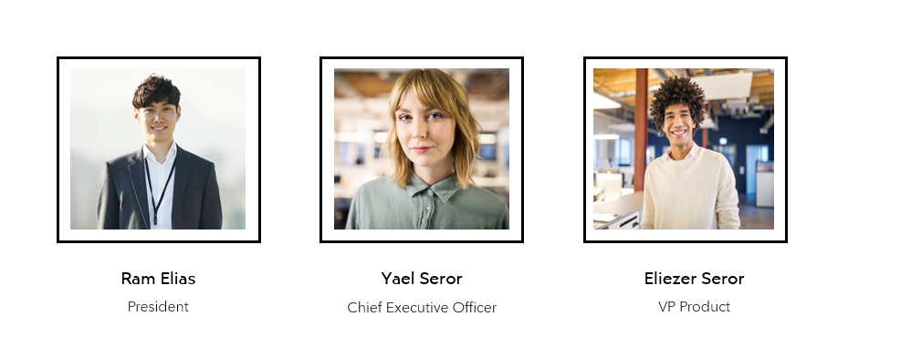





MEET THE TEAM
Ram Elias
Yael Seror
Eliezer Seror
President
Chief Executive Officer
VP Product

Slide 20
Thank you
We highly encouraged you to place a review ☺

